Slide 1
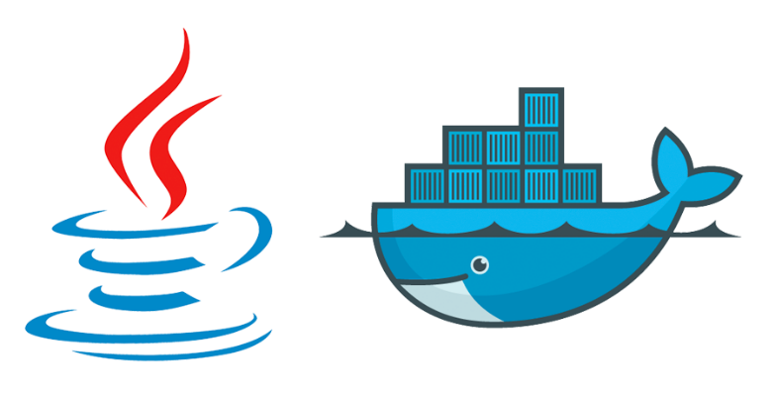
Docker for java developers Day 2
Dmitry Buhtiyarov, Siarhei Beliakou, 2018

Slide 2
Why Docker
Rapid application deployment – containers include the minimal runtime requirements of the application, reducing their size and allowing them to be deployed quickly.
Portability across machines – an application and all its dependencies can be bundled into a single container that is independent from the host version of Linux kernel, platform distribution, or deployment model. This container can be transfered to another machine that runs Docker, and executed there without compatibility issues.
Version control and component reuse – you can track successive versions of a container, inspect differences, or roll-back to previous versions. Containers reuse components from the preceding layers, which makes them noticeably lightweight.
Sharing – you can use a remote repository to share your container with others. Red Hat provides a registry for this purpose, and it is also possible to configure your own private repository.
Lightweight footprint and minimal overhead – Docker images are typically very small, which facilitates rapid delivery and reduces the time to deploy new application containers.
Simplified maintenance – Docker reduces effort and risk of problems with application dependencies.

Slide 3
Agenda
Control Groups / Namespaces
Docker Compose
Monitoring Containers
Demo

Slide 4
Namespaces and control groups
Cgroups: Memory/CPU
Memory Constraints
CPU Constraints

Slide 5
Cgroups: Memory Limits
# docker run -d centos sleep infinity
60614832f3ba25962c584d209a0ba1f99335c3c980563c72715ac14175fada5f
# docker stats --no-stream --format "table {{.Container}}\t{{.MemUsage}}" 60614832f3ba
CONTAINER MEM USAGE / LIMIT
60614832f3ba 92KiB / 991.6MiB
# docker run -d -m 300M centos sleep infinity
b133cd44aa414645f94474ffdc49b7d31b7cccfcb14a122f8f0700bb0b7c80bd
# docker stats --no-stream --format "table {{.Container}}\t{{.MemUsage}}" b133cd44aa41
CONTAINER MEM USAGE / LIMIT
b133cd44aa41 1016KiB / 300MiB
# docker run -d -m 300M --memory-reservation 100M centos sleep infinity
af6df26f67538433932f2ab9957afa2eaec586dedae5a99c837df2a5be6e2c18
# docker stats --no-stream --format "table {{.Container}}\t{{.MemUsage}}"
CONTAINER MEM USAGE / LIMIT
af6df26f6753 968KiB / 300MiB
b133cd44aa41 1016KiB / 300MiB
60614832f3ba 92KiB / 991.6MiB
Check out documentation:
container memory constraints
docker stats reference

Slide 6
Cgroups: CPU Limits
2. CPU Shares
CPU limits are based on shares. These shares are a weight between how much processing time one process should get compared to another. If a CPU is idle, then the process will use all the available resources. If a second process requires the CPU then the available CPU time will be shared based on the weighting.
--cpu-shares - CPU shares (relative weight).
--cpu-period - Limit CPU CFS (Completely Fair Scheduler) period.
--cpu-quota - Limit CPU CFS (Completely Fair Scheduler) quota.
--cpuset-cpus - CPUs in which to allow execution (0-3, 0,1).
--cpuset-mems - MEMs in which to allow execution (0-3, 0,1).
The --cpu-quota option specifies the number of microseconds that a container has access to CPU resources during a period specified by --cpu-period. As the default value of --cpu-period is 100000, setting the value of --cpu-quota to 25000 limits a container to 25% of the CPU resources. By default, a container can use all available CPU resources, which corresponds to a --cpu-quota value of -1
# docker run -it -d --cpu-quota=25000 --name cpu0.25 benhall/stress
# docker stats --no-stream --format "table {{.Name}}\t{{.CPUPerc}}" cpu0.25
NAME CPU %
cpu0.25 25.03%
Notes:
https://goldmann.pl/blog/2014/09/11/resource-management-in-docker/
https://www.kernel.org/doc/Documentation/scheduler/sched-design-CFS.txt
https://www.serverlab.ca/tutorials/containers/docker/how-to-limit-memory-and-cpu-for-docker-containers/
systemd-cgtop

Slide 7
Building Images with Resource Constraints
From version 1.6.0 of Docker, you can specify cgroup resource constraints to docker build, for example:
# docker build \
--cpu-shares=100 \
--memory=128M \ \
--tag="mymod/myapp:1.0" \
/var/docker_projects/myapp/
Any containers that you generate from the image inherit these resource constraints.
You can use the docker stats command to display a container's resource usage, for example:
# docker stats cntr1 cntr2
CONTAINER CPU % MEM USAGE/LIMIT MEM % NET I/O
cntr1 0.05% 504 KiB/128 MiB 0.39% 2.033 KiB/40 B
cntr2 0.08% 1.756 MiB/128 MiB 1.37% 5.002 KiB/92 B

Slide 8
Docker Compose
Commands
Docker Compose File
Managing Containers with Docker Compose
Customizing Container Settings
Building Images with Docker Compose

Slide 9
What docker-compose is
Compose is a tool for defining and running multi-container Docker applications. The Compose file is a YAML file defining services, networks and volumes.
The default path for a Compose file is ./docker-compose.yml
To learn more about all the features of Compose please take a look at the list of features.
Use Cases:
Development environments
Automated testing environments
Single host deployments
Installing:
https://docs.docker.com/compose/compose-file/
https://docs.docker.com/compose/overview/
https://medium.freecodecamp.org/the-ups-and-downs-of-docker-compose-how-to-run-multi-container-applications-bf7a8e33017e
$ pip install docker-compose
$ docker-compose --version
docker-compose version 1.22.0, build f46880f

Slide 10
Docker-compose Commands
Lifecycle:
create - Create services
start - Start services
stop - Stop services
restart - Restart services
kill - Kill containers
pause - Pause services
unpause - Unpause services
up [-d] - Create and start containers [detached mode]
down - Stop and remove containers, networks, images, and volumes
Info, Logs:
ps - List containers
port - Print the public port for a port binding
top - Display the running processes
logs - View output from containers
Build and Validate:
build - Build or rebuild services
config - Validate and view the Compose file
Working with Registry:
pull - Pull service images
push - Push service images

Slide 11
Docker-compose file
Generally, docker-compose file may consist of following parts:
version:
networks:
services:
volumes:
configs:
Traditional command:
$ docker run -d --restart always -e MYSQL_ROOT_PASSWORD=password mariadb
docker-compose.yml
version: "2"
services:
mariadb:
image: mariadb
restart: always
environment:
MYSQL_ROOT_PASSWORD: password

Slide 12
Managing Containers with Docker-compose
[vagrant@docker-host project_dir]$ docker-compose up -d
Creating network "project_dir_default" with the default driver
Creating project_dir_mariadb_1 ... done
[vagrant@docker-host project_dir]$ docker-compose ps
Name Command State Ports
-----------------------------------------------------------------------
project_dir_mariadb_1 docker-entrypoint.sh mysqld Up 3306/tcp
$ docker ps
CONTAINER ID IMAGE COMMAND CREATED STATUS PORTS NAMES
6c71eea413eb mariadb "docker-…" 29 seconds ago Up 28 seconds 3306/tcp project_dir_mariadb_1
$ docker-compose exec mariadb mysqladmin -ppassword version
mysqladmin Ver 9.1 Distrib 10.3.8-MariaDB, for debian-linux-gnu on x86_64
Copyright (c) 2000, 2018, Oracle, MariaDB Corporation Ab and others.
Server version 10.3.8-MariaDB-1:10.3.8+maria~bionic
Protocol version 10
Connection Localhost via UNIX socket
UNIX socket /var/run/mysqld/mysqld.sock
Uptime: 7 min 31 sec
Threads: 7 Questions: 5 Slow queries: 0 Opens: 17 Flush tables: 1 Open tables: 11 Queries per second avg: 0.011

Slide 13
Managing Containers with Docker-compose
[vagrant@docker-host project_dir]$ docker-compose images
Container Repository Tag Image Id Size
-------------------------------------------------------------------
project_dir_mariadb_1 mariadb latest 2c73b3262fff 346 MB
[vagrant@docker-host project_dir]$ docker-compose logs mariadb
Attaching to project_dir_mariadb_1
mariadb_1 | Initializing database
...
mariadb_1 | Database initialized
mariadb_1 | MySQL init process in progress...
mariadb_1 | 2018-08-07 11:36:10 0 [Note] mysqld (mysqld 10.3.8-MariaDB-1:10.3.8+maria~bionic) starting as process 101 ...
mariadb_1 | 2018-08-07 11:36:10 0 [Note] InnoDB: Using Linux native AIO
[vagrant@docker-host project_dir]$ docker-compose restart mariadb
Restarting project_dir_mariadb_1 ... done
[vagrant@docker-host project_dir]$ docker-compose stop mariadb
Stopping project_dir_mariadb_1 ... done
[vagrant@docker-host project_dir]$ docker-compose down
Removing project_dir_mariadb_1 ... done
Removing network project_dir_default

Slide 14
Specifying Container Name
$ docker ps
CONTAINER ID IMAGE COMMAND CREATED STATUS PORTS NAMES
6c71eea413eb mariadb "docker-…" 29 seconds ago Up 28 seconds 3306/tcp project_dir_mariadb_1
version: "2"
services:
mariadb:
image: mariadb
container_name: mariadb
environment:
MYSQL_ROOT_PASSWORD: password
version: "2"
services:
mariadb:
image: mariadb
container_name: mariadb
environment:
- MYSQL_ROOT_PASSWORD=password
$ docker-compose up -d
Creating network "project_dir_default" with the default driver
Creating mariadb ... done
$ $ docker ps
CONTAINER ID IMAGE COMMAND CREATED STATUS PORTS NAMES
f9c0bec8b381 mariadb "docker-…" 38 seconds ago Up 37 seconds 3306/tcp mariadb

Slide 15
Env Variables, Volumes, Ports, Logging Options Ulimits
version: "3"
services:
jenkins:
image: jenkins
environment:
- HOME=/opt/jenkins/home
- JENKINS_HOME=/opt/jenkins/home
env_file:
- ./env_file
ports:
- "127.0.0.1:8080:8080"
- "127.0.0.1:50000:50000/tcp"
volumes:
- /opt/jenkins/home:/opt/jenkins/home
logging:
options:
tag: jenkins
ulimits:
nproc: 65535
nofile:
soft: 20000
hard: 40000

Slide 16
Networks and Network Modes in Docker-Compose
Networks to join, referencing entries under the top-level networks key
Network mode. Use the same values as the docker client --network parameter, plus the special form service:[service name]
services:
some-service:
networks:
- some-network
- other-network
another-service:
networks:
- other-network
networks:
frontend:
name: some-network
driver: custom-driver-1
backend:
name: other-network
driver: custom-driver-2
services:
some-service:
network_mode: bridge
host-placed-service:
network_mode: host
none-placed-service:
network_mode: none
service-in-other-service-net:
network_mode: service:[service-name]
service-in-other-container-net:
network_mode: container:[container-name/id]

Slide 17
User Defined Networks
version: "3.3"
services:
some-service:
image: centos
container_name: some-service
command: sleep infinity
networks:
- backtier
networks:
backtier:
driver: bridge
ipam:
config:
- subnet: 172.126.0.0/16
version: "2.3"
services:
some-service:
image: centos
command: sleep infinity
networks:
mynet:
ipv4_address: 172.21.0.2
networks:
mynet:
driver: bridge
ipam:
driver: default
config:
- subnet: 172.21.0.0/16
gateway: 172.21.0.1
Notes:
docker inspect 46_backtier | jq '.[] | .Containers'

Slide 18
Working with Networks
Pay attention to Compose Version! This doesn’t work on the latest one.
version: "???"
services:
infinity:
image: sbeliakou/centos
command: sleep infinity
networks:
mynet:
ipv4_address: 172.155.0.2
networks:
mynet:
driver: bridge
ipam:
driver: default
config:
- subnet: 172.155.0.0/16
gateway: 172.155.0.1
# 2.3
Creating network "mynet" with driver "bridge"
Creating infinity_1 ... done
# 3.3
ERROR: The Compose file is invalid because:
networks.mynet value Additional properties are not allowed ('enable_ipv6' was unexpected)
networks.mynet.ipam.config value Additional properties are not allowed ('gateway' was unexpected)
# unspecified
ERROR: The Compose file is invalid because:
Unsupported config option for services: 'infinity'
Unsupported config option for networks: 'mynet'
Notes:
https://docs.docker.com/v17.12/compose/compose-file/compose-versioning/

Slide 19
Using External Networks
$ docker network create tools-docker-network
version: "3"
services:
infinity:
image: sbeliakou/centos
command: sleep infinity
networks:
default:
external:
name: tools-docker-network

Slide 20
Using Volumes in Docker-Compose
version: "3"
services:
mariadb1:
image: mariadb
container_name: mariadb1
volumes:
- mariadb_storage:/var/lib/mysql
- ./:/data/in/container/taken/from/the/host
- /full/path:/mountpoint/in/container
environment:
MYSQL_ROOT_PASSWORD: password
volumes:
mariadb_storage:
Notes:
vs 45 slide

Slide 21
Building Images with Docker Compose
frontend.Dockerfile
FROM httpd
LABEL maintainer="Siarhei Beliakou (sbeliakou@gmail.com)"
backend.Dockerfile
FROM tomcat
LABEL maintainer="Siarhei Beliakou (sbeliakou@gmail.com)"
docker-compose.yml
version: "3"
services:
frontend:
build:
context: .
dockerfile: frontend.Dockerfile
backend:
build:
context: .
dockerfile: backend.Dockerfile

Slide 22
Healthcheck
Configure a check that’s run to determine whether or not containers for this service are “healthy”. See the docs for the HEALTHCHECK Dockerfile instruction for details on how healthchecks work.
healthcheck:
test: ["CMD", "curl", "-f", "http://localhost"]
interval: 1m30s
timeout: 10s
retries: 3
# start_period is only supported for v3.4 and higher of the compose file format
start_period: 40s
healthcheck:
disable: true

Slide 23
Building Images with Docker Compose
The following only builds the images, does not start the containers:
# docker-compose build
The following builds the images if the images do not exist and starts the containers
# docker-compose up -d
If you add the --build option, it is forced to build the images even when not needed:
# docker-compose up -d --build
The following skips the image build process:
$ docker-compose up -d --no-build
The --no-cache option disables the Docker build cache in the image creation process. This is used to cache each layer in the Dockerfile and to speed up the image creation reusing layers (~ Dockerfile lines) previously built for other images that are identical.

Slide 24
Monitoring Containers
What you should look after
Containers Monitoring with cAdvisor

Slide 25
What You Should Look after
At least:
Image Count - The count of active and inactive images stored locally by Docker.
Image Size - The total disk usage of active and reclaimable images stored locally.
Container Count - The count of containers, segragated by state: created, running, paused, restarting, removing, exited and dead.
Container Size - The total size of disk used by containers, with used and reclaimable parts tracked separately.
Volume Count - The count of active and inactive volumes maintained by this Docker daemon.
Volume Size - The total size of disk used by volumes, with used and reclaimable parts tracked separately.
CPU Usage - The percentage of host CPU used by all currently running containers.
Memory Usage - The amount of host memory used by all currently running containers.
Network Bandwidth - The transmit and receive bandwidth of host network used by all currently running containers.
Disk Throughput - The disk read and write throughput (bytes/second) used by all currently running containers.
Process Count - The total number of processes running across all containers currently.

Slide 26
Monitoring Containers with cAdvisor
version: "3.6"
services:
web:
image: google/cadvisor:latest
ports:
- 0.0.0.0:9104:8080
volumes:
- /:/rootfs:ro
- /var/run:/var/run:rw
- /sys:/sys:ro
- /var/lib/docker/:/var/lib/docker:ro
- /dev/disk/:/dev/disk:ro
# docker-compose up -d

Slide 27
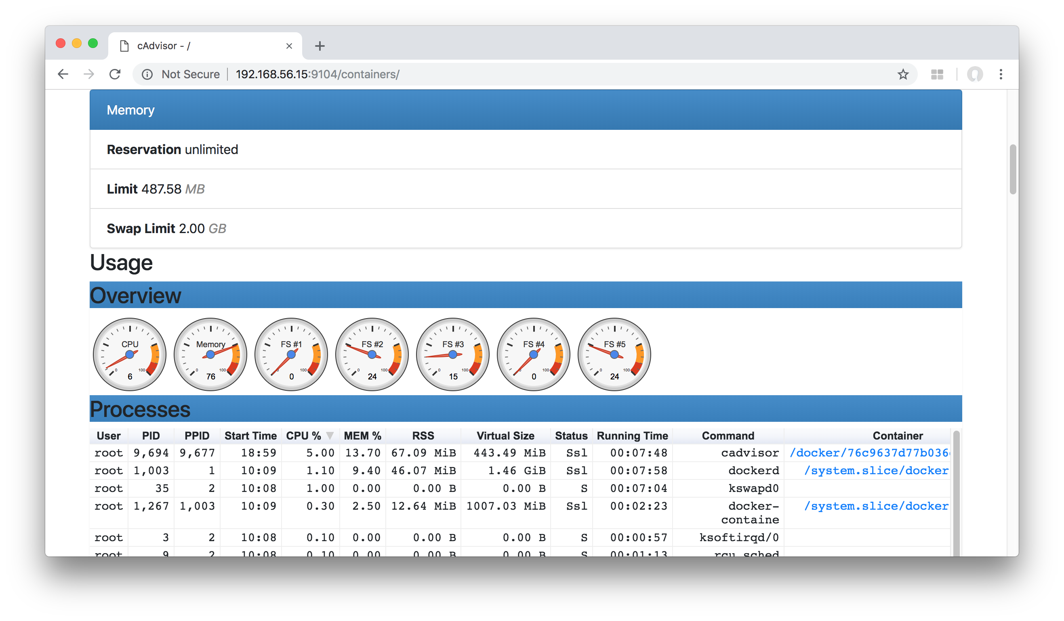

Slide 28
Useful Commands: Getting Info
# docker system info
# docker system df
# docker system df -v
# docker ps -s
# docker stats
# docker ps -f status=exited
# docker images -f dangling=true
# docker volume ls -f dangling=true

Slide 29
Useful Commands: Cleaning Up
# docker image prune
WARNING! This will remove all dangling images.
Are you sure you want to continue? [y/N]
you want to continue? [y/N]
# docker container prune
WARNING! This will remove all stopped containers.
Are you sure you want to continue? [y/N]
# docker volume prune
WARNING! This will remove all volumes not used by at least one container.
Are you sure you want to continue? [y/N]
# docker network prune
WARNING! This will remove all networks not used by at least one container.
Are you sure you want to continue? [y/N]
# docker system prune
WARNING! This will remove:
- all stopped containers
- all networks not used by at least one container
- all dangling images
- all build cache
Are you sure you want to continue? [y/N]
Notes:
https://oracle-base.com/articles/linux/docker-clean-up-unwanted-containers-images-layers-volumes-networks

Slide 30
Demo
https://github.com/dbuhtiyarov/docker-demo/tree/master/elk
Notes:
https://oracle-base.com/articles/linux/docker-clean-up-unwanted-containers-images-layers-volumes-networks

Slide 31
Thank you for your attention!
Day 2
Dmitry Buhtiyarov, Siarhei Beliakou
2018

